Slide 1
Loan Default Prediction
Supervised Machine Learning Algorithms
Cohort 2 Group 1

Slide 2
Agenda
Introduction
01
Background, Purpose and Scope
Methodology
02
Binary classification, Feature selection, Evaluation techniques
Data Preprocessing
03
Data description, Exploratory data analysis and Variable selection

Slide 3
Agenda
Results
04
Performance of methods and best performing method
Discussion
05
Findings, Impact of variable selection methods
Recommendations
06
Future work on further development of the model

Slide 4
Introduction

Slide 5
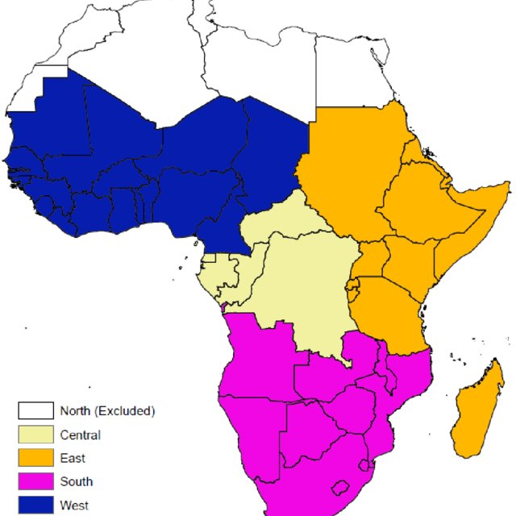
Background
Countries in Sub-Saharan Africa (SSA) have been hurt economically by the Covid-19 pandemic, with a regional GDP contraction of 3.3% expected this year [1].
Households and firms find finance as a major constraint in their daily lives.
Recent research has shown that banks are deterred from lending by a very high rate of loan defaults [2].
Source: https://www.google.com/Sub-regions-of-Sub-Saharan-Africa-see-online-version-for-colours_Q640.jpg&imgrefurl=https%3A%2F%2Fwww.researchgate.net%2Ffigure%2FSub-regions-of-Sub-Saharan-Africa-see-online-version-for-colours

Slide 6

Problem Identification
The main importance of financial institutions, particularly banks, are to safeguard the money kept by their clients and make it accessible when need arises.
They also advance loans to their customers [3].
James Mwangi, CEO of Equity Bank, responds in the affirmative: With even small loans, he told Africa Renewal, “We have seen families graduate from micro-enterprises to semi-medium enterprises.” [3].
This brings the need to understand the determinants of loan default rates in Africa so as to overcome the obstacles to financial development in Africa.

Slide 7

Problem Identification
Accurate prediction of default risk in lending is a crucial theme for banks and other lenders to avoid huge losses that result from wrong decisions [4].
Customers in default means that they did not meet their contractual obligations and potentially might not be able to repay their loans.
This brings the interest of acquiring a model that can predict defaulted customers [5].
In this project, a set of machine learning methods were investigated and studied in order to test if they can challenge traditionally applied techniques.

Slide 8
Value Proposition
SDG Goal 1: No Poverty
Global Challenge 9: Education and Learning
Promotes high-impact loan alternatives to low-income individuals
Opting for an education loan reduces the strain on your family savings and eliminates the need to liquidate your investments in fixed deposits, mutual funds or bonds.
SDG Goal 8:
Economic Growth
Promotes the ability to start up or expand businesses
Global Challenge 7:
Rich - poor gap
Microcredits help the poor engage in successful entrepreneurship and improve their quality of life.
Source: http://www.millennium-project.org/15-global-challenges/, https://en.wikipedia.org/wiki/Sustainable_Development_Goals#:~:text=The%2017%20SDGs%20are%3A%20

Slide 9
Scope of the Project
The project will be performed using internal data of SuperLender customers, a local digital lending company in Nigeria.
Data Source
Method
Implement and investigate how different supervised binary classification methods impact default prediction
Classifiers: Logistic Regression, Decision Tree, Random Forest, Gaussian Naive Bayes, XGBoost, Gradient Boosting Classifier
Models Used
Evaluation Techniques
The model evaluation techniques used in this project are limited to precision, F-score and accuracy score.

Slide 10
Methodology

Slide 11
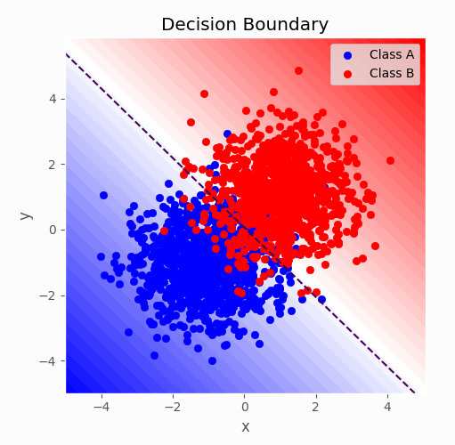
Binary Classification Problem
The case where the input to a model is classified to belong to one of two chosen categories.
Customers belong either to the non-default category or to the default category, where 0 or ‘Bad’ is defined as default, while 1 or ‘Good’ corresponds to default, and is the target variable.
The rest of the information about the customers, such as loan amounts and payments in arrears can be modeled as the input features.
The main characteristic of supervised machine learning is that the target variable is known and therefore an inference between the target variable and the features can be made [6].
Source: https://www.google.com/url?sa=i&url=http%3A%2F%2Fscikit-hep.org%2Froot_numpy%2Fauto_examples%2Ftmva%2Fplot_twoclass.html&psig=AOvVaw32szQIjHjAFPbHwD7N-xIn&ust=1619712268020000&source=images&cd=vfe&ved=0CAIQjRxqFwoTCMih18aoofACFQAAAAAdAAAAABBK

Slide 12
Feature Selection Methods
Kendall’s Tau rank correlation analysis
It measures the ordinal association between two measured variables, thus, it is a univariate method of correlation analysis [7].
It does not rely on any assumptions of distributions between the analyzed variables [8].
Recursive Feature Elimination (RFE)
It is a multivariate method of variable selection [9], which performs a backward selection of predictors [10].
The algorithm starts with computing an importance score for each predictor in the whole data set.
For each iteration, the number of predictors which have been top-ranked are retained in the model [11].
The importance scores are computed again and the performance is reassessed.

Slide 13
Treatment of Imbalanced Data
In the data provided, a heavy class imbalance exhibits. An imbalanced data set contains observations where the classes of the response variable are not approximately equally represented.
The imbalance causes a problem when training machine learning algorithms since one of the categories is almost absent, hence poor predictions of new observations of the minority class are expected.
SMOTE (Synthetic Minority Over-sampling Technique) is a sampling algorithm that creates synthetic data points for the minority class rather than sampling existing observations with replacement [12]. The method is applied on the continuous parameters for each sample in the minority class.

Slide 14
Evaluation Techniques

Slide 15
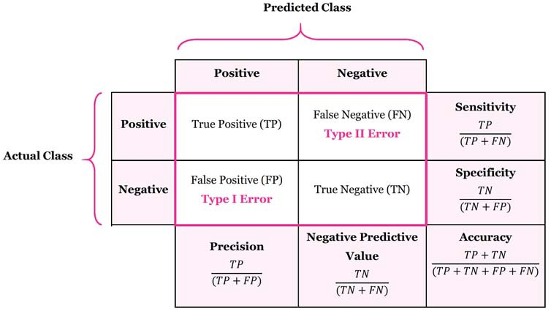
Confusion Matrix
The aim is to achieve a trade-off between losing money on non-performing customers and opportunity cost caused by declining of a potentially performing customer.
Sensitivity and precision are the most relevant methods, as sensitivity is a measure of how many defaulted customers are captured by the model, while precision relates to the potential opportunity cost.
We settled on the F-score since it is the weighted harmonic average of precision and sensitivity [13].
Source: https://www.google.com/url?sa=i&url=https%3A%2F%2Fmedium.com%2Fember-all-these-classification-concepts-forever-761c065be33&psig=AOv

Slide 16

Cross Validation
To prevent using the same information in the training phase and the evaluation phase of models, which makes the results less reliable, the data is divided into training set, validation set and test set [14].
The training set and validation set are used for finding the best model and the test set is only used for calculating the prediction performance of the best model [13].
Source: https://www.google.com/url?sa=i&url=http%3A%2F%2Fscikit-learn.org%2Fstable%2Fmodules%2Fcross_validation.html&psig=AOvVaw0kMrCHUCeSS5PdZ2h80tPE&ust=1619715752070000&source=images&cd=vfe&ved=0CAIQjRxqFwoTCJD0jMi1ofACFQAAAAAdAAAAABAa

Slide 17
Data Preprocessing

Slide 18
Data Preprocessing
Data Collection
Data Visualization
18,183 loan applicants whose loans had been approved by 18 banks was obtained
Plotting for high-level intuition of some of the relationships between different variables.
01
02
04
03
Exploratory Data Analysis
Data Cleaning
Information derived was what type of accounts a customer possessed and how they behaved over time.
Missing values were treated by doing a complete case analysis. The data was then coded for easy analysis.

Slide 19
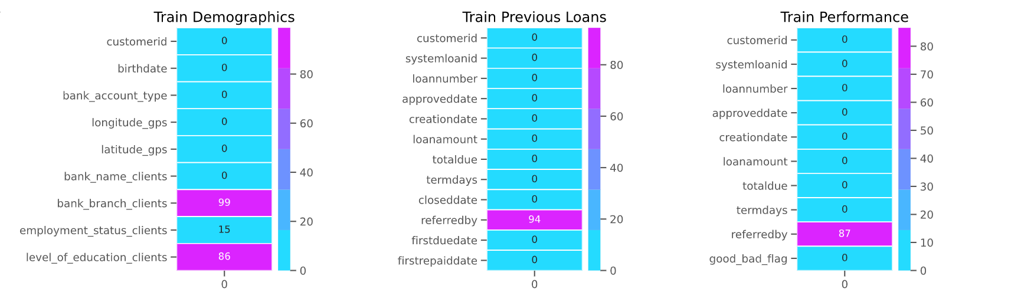
Missing Values (%)

Slide 20
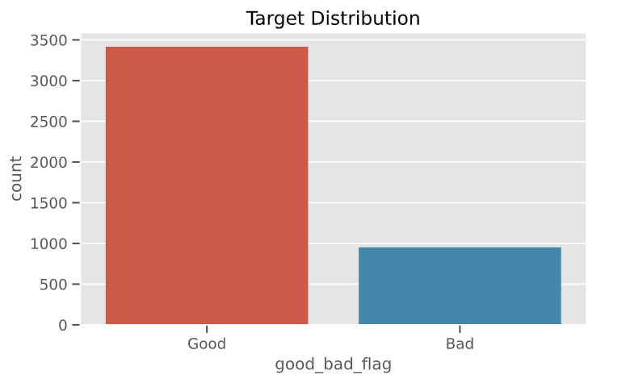
Target Variable
Good = 3416
Customers who paid their loan on time
Bad = 952
Customers who defaulted on their loans

Slide 21
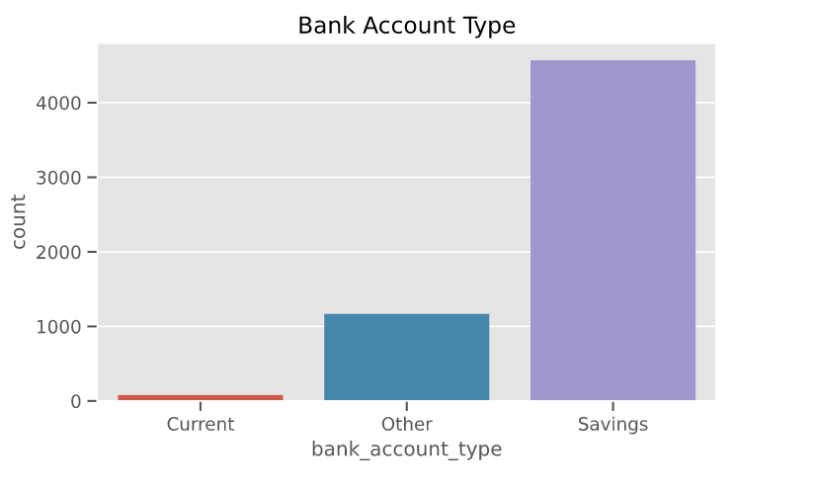
Bank Account Type
Savings = 4570
Other = 1168
Current = 80

Slide 22
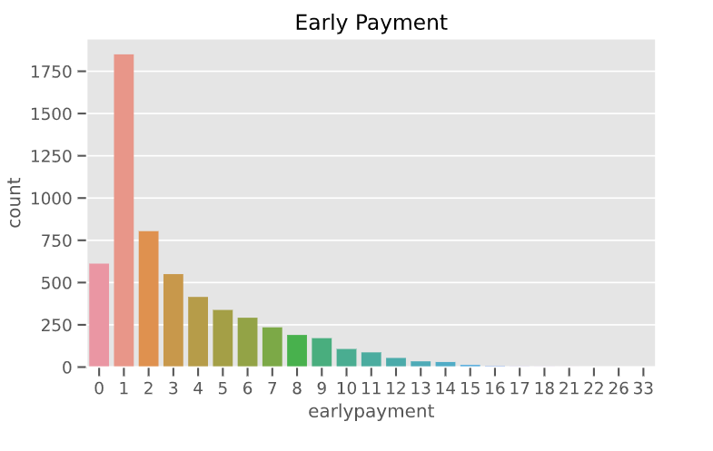
Early Payments

Slide 23
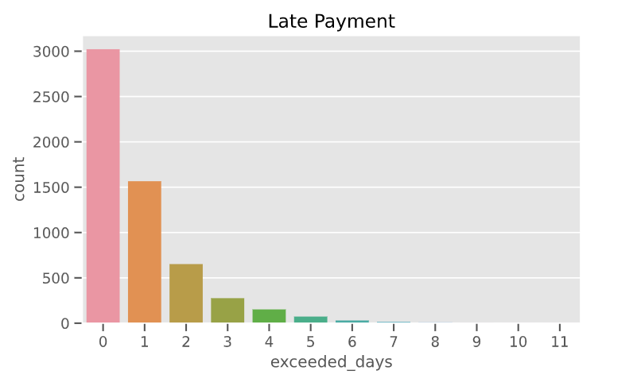
Late Payments

Slide 24
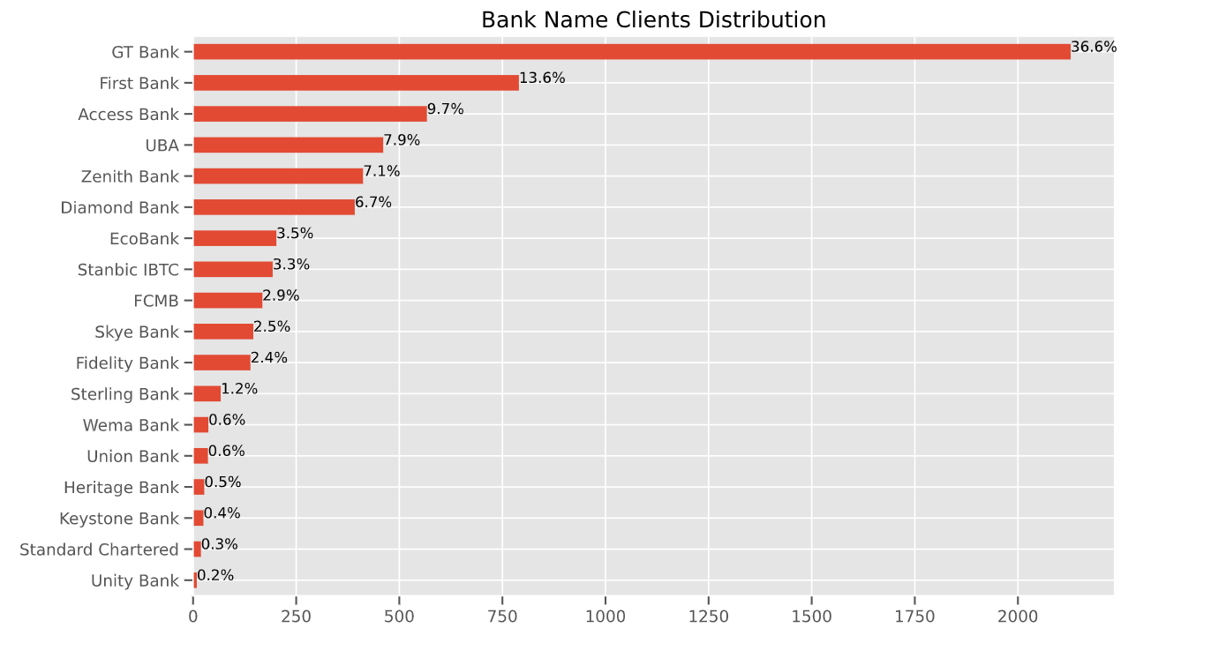
Bank Names of Clients
18 banks in total

Slide 25
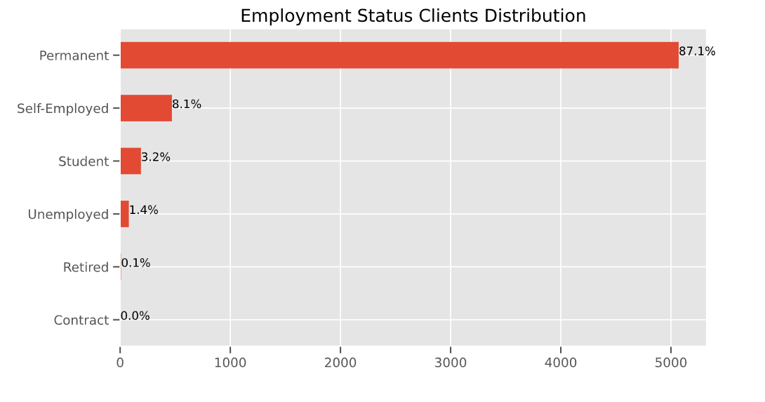
Clients’ Employment Status

Slide 26
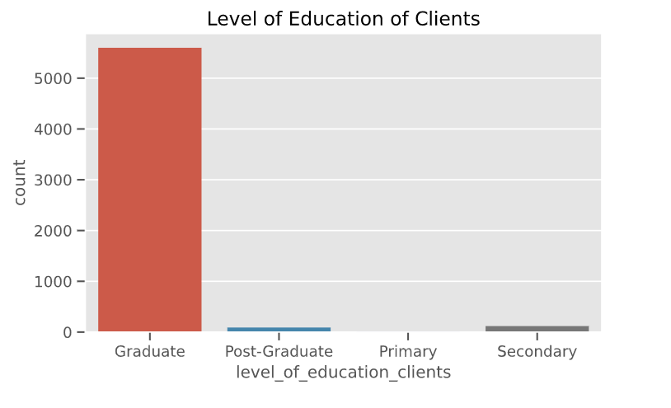
Clients’ Level of Education
Graduate = 5599
Secondary = 118
Post-Graduate = 90
Primary = 11

Slide 27
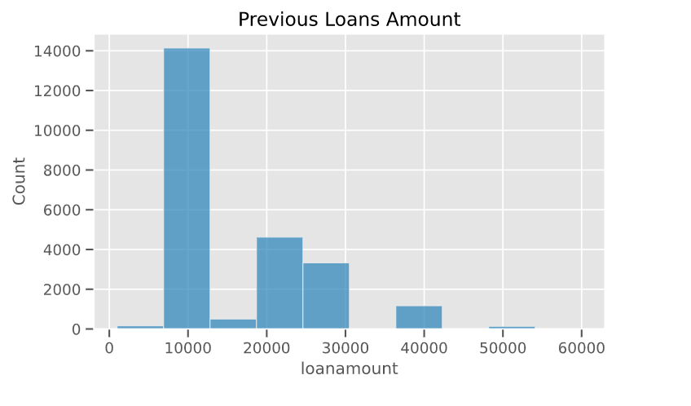
Loan Amounts

Slide 28
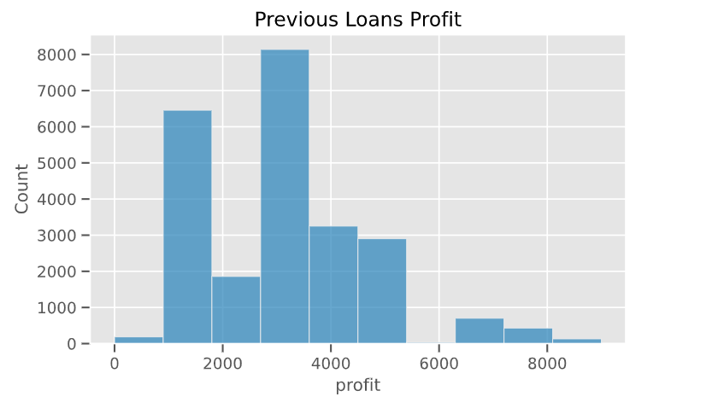
Loans Profit

Slide 29
Variable Selection
Train Data Dimension:
5818 rows by 35 columns
Some variables have strong correlation, which should be treated.
The threshold was chosen to 0.7, because pairwise correlation higher than 0.7 leads to unstable estimates and multicollinearity [15].
After the threshold was decided, the variable which correlates the most with the response variable was kept.
For the sake of getting a multivariate based variable selection, RFE was implemented.
The variable selection by RFE was performed only on the behavioral variables with a Random Forest classifier with F-score as a scoring evaluation [16].

Slide 30
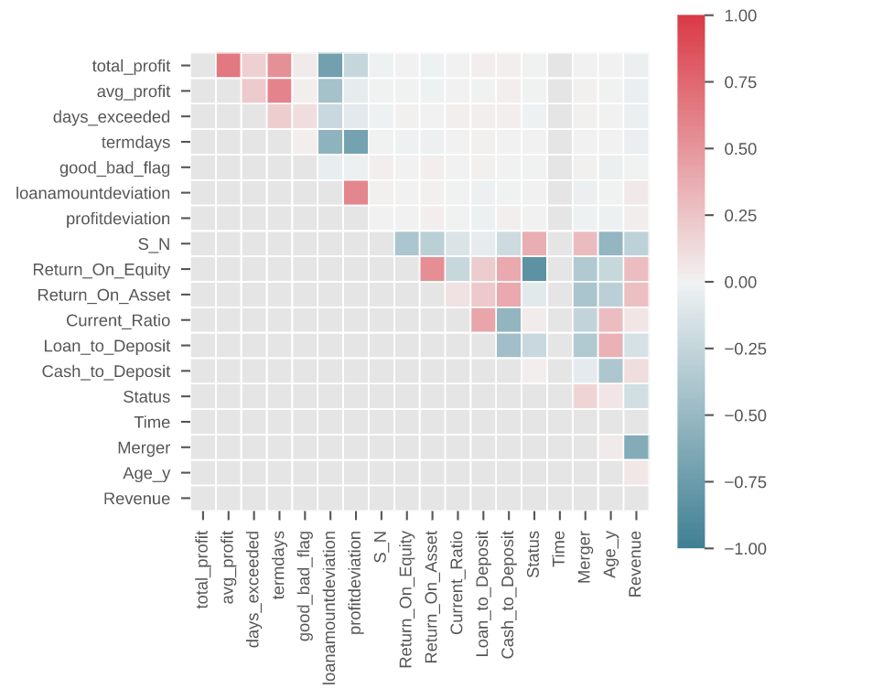
Variable Selection by Correlation Analysis - 30 features

Slide 31
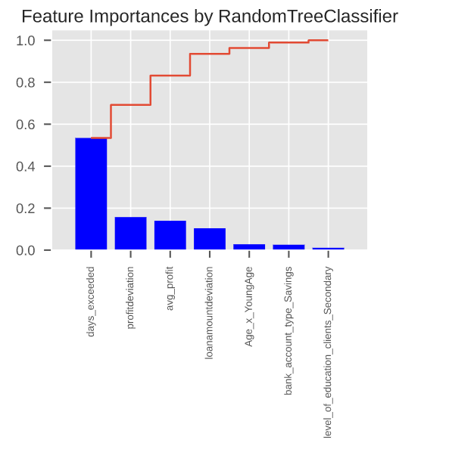
Variable Selection by RFE - 7 features

Slide 32
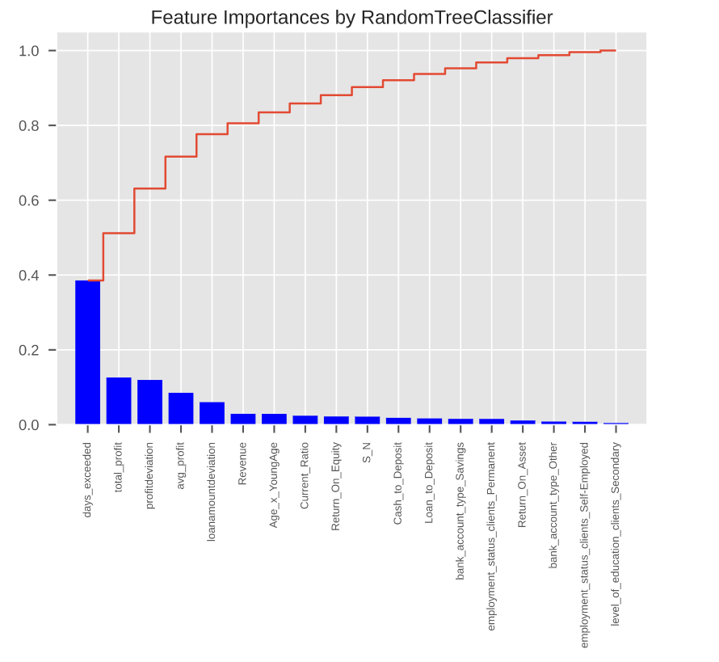
Variable Selection by RFE - 18 features

Slide 33
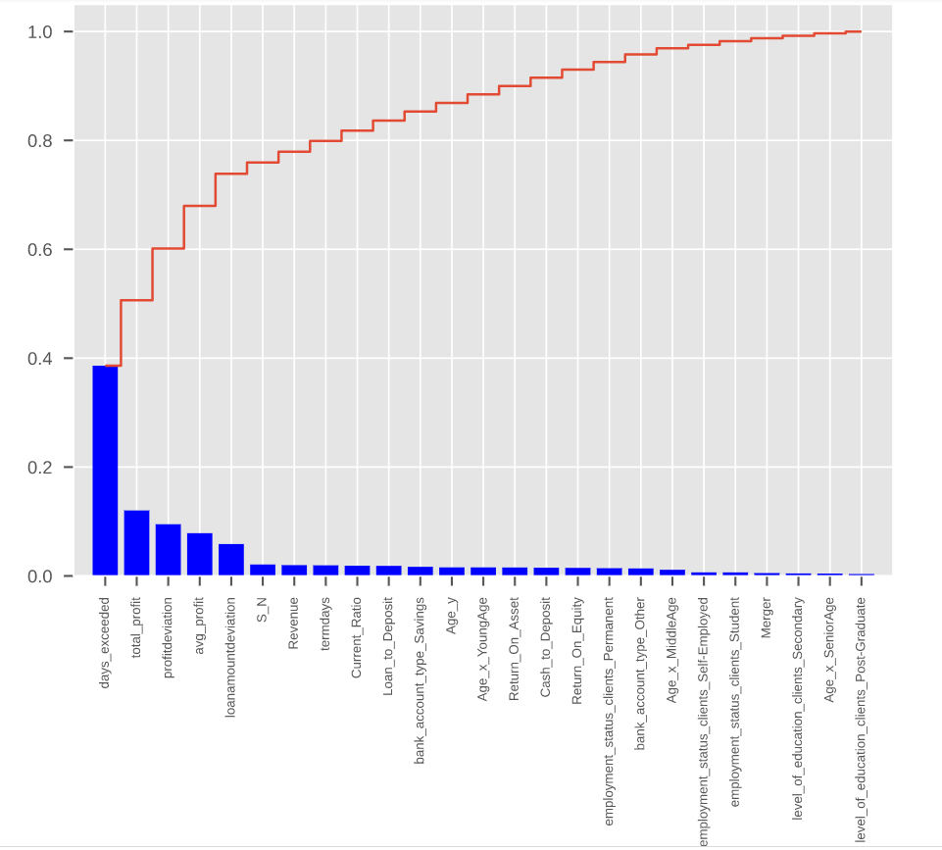
Variable Selection by RFE - 25 features

Slide 34
Results

Slide 35
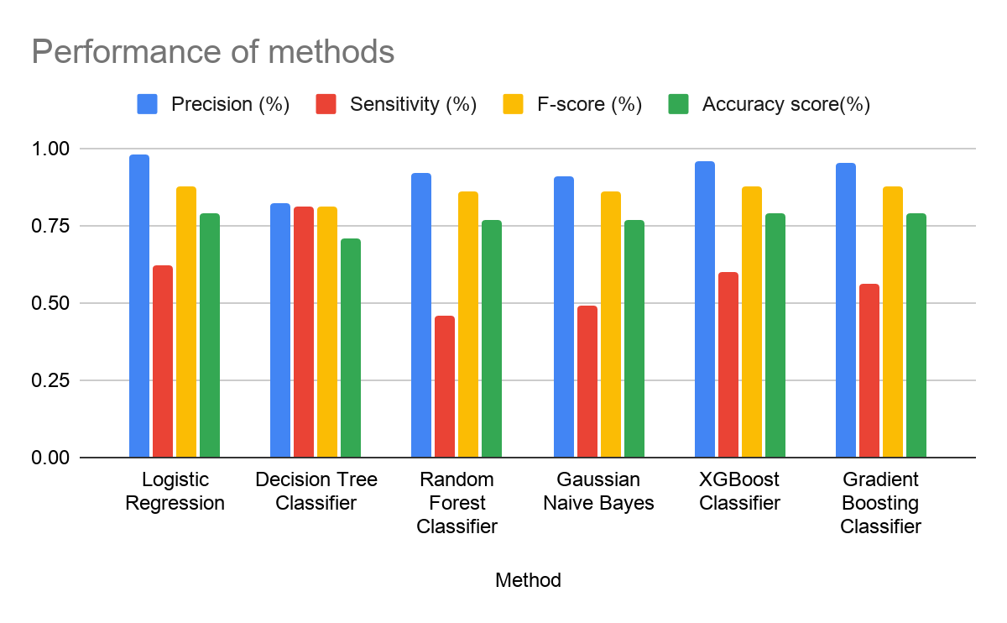
Performance of the methods

Slide 36
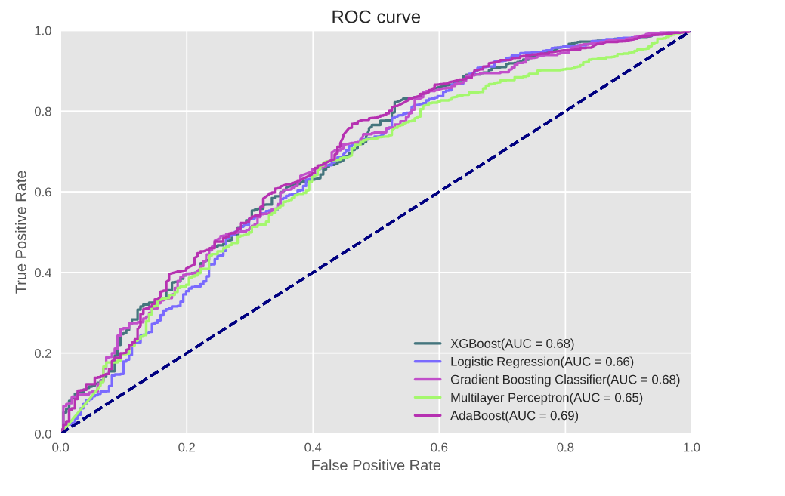
Comparing ROC curves of top 5 models
The true positive rate (TPR, also called sensitivity) is calculated as TP/TP+FN. TPR is the probability that an actual positive will test positive [14].
False positive rate (also known as fall-out or false alarm ratio) is the ratio between the number of negative events wrongly categorized as positive and the total number of actual negative events [14].

Slide 37
Summary Performance of the Methods
Table 4.1: Performance of Methods with regards to chosen performance measurements
Variable Selection | Number of Features | Method | Precision (%) | Sensitivity (%) | F-score (%) | ROC-score | Accuracy score
Correlation analysis with Kendall’s Tau | 30 | Logistic Regression | 0.985 | 0.567 | 0.888 | 0.687 | 0.801
 | 30 | Decision Tree Classifier | 0.768 | 0.298 | 0.798 | 0.561 | 0.691
 | 30 | Random Forest Classifier | 0.886 | 0.376 | 0.858 | 0.605 | 0.762
 | 30 | Gaussian Naive Bayes | 0.890 | 0.417 | 0.862 | 0.626 | 0.773
 | 30 | XGBoost Classifier | 0.970 | 0.606 | 0.891 | 0.715 | 0.810
 | 30 | Gradient Boosting Classifier | 0.959 | 0.534 | 0.885 | 0.674 | 0.803
RFE | 7 | XGBoost Classifier | 0.746 | 0.705 | 0.817 | 0.804 | 0.802
 | 18 | XGBoost Classifier | 0.735 | 0.689 | 0.809 | 0.794 | 0.792
 | 25 | XGBoost Classifier | 0.733 | 0.688 | 0.807 | 0.792 | 0.7890

Slide 38
Best Model: XGBoost

Slide 39
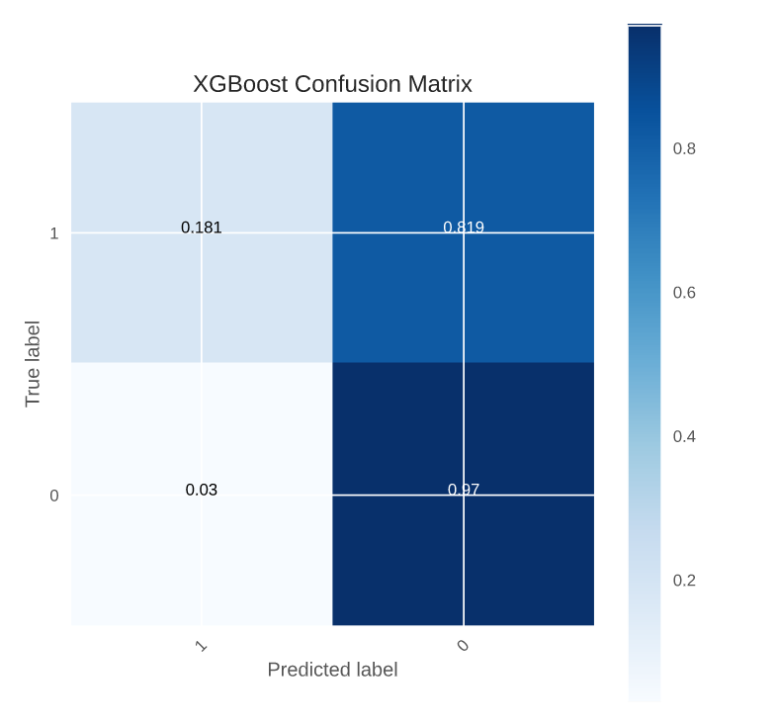
XGBoost Confusion Matrix
True Positive (TP): 0.181
Model predicted ‘good’ flag and it’s true
True Negative (TN): 0.97
Model predicted ‘bad’ flag and it’s true
False Positive (FP) Type 1 Error: 0.819
Model predicted ‘good’ flag and it’s false
False Negative (FN) Type 2 Error: 0.03
Model predicted ‘bad’ flag and it’s false [14].

Slide 40
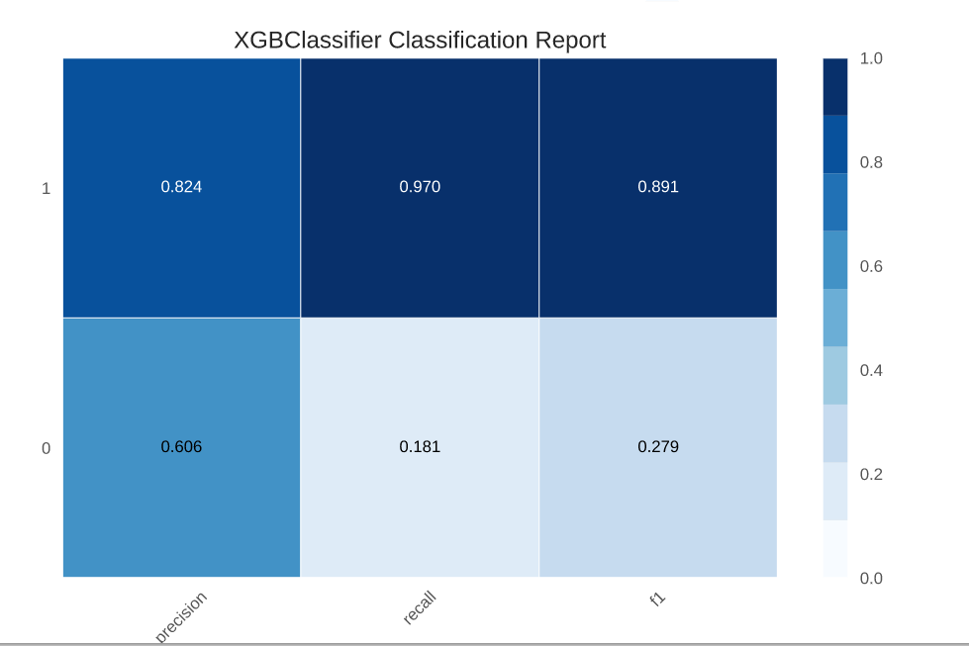
XGBoost Classification Report
Precision is the ability of a classifier not to label an instance positive that is actually negative.
-> Precision = TP/(TP + FP)
Recall is the ability of a classifier to find all positive instances.
-> Recall = TP/(TP+FN)
The F1 score is a weighted harmonic mean of precision and recall
-> F1 Score = 2*(Recall * Precision) / (Recall + Precision) [14].

Slide 41
Discussion

Slide 42
Findings and Conclusions
Tree-Based Models
Results indicated that tree-based models showed a good performance on average. In order to test if this relation exhibits generally, more tests should be done and different sets of classifiers should be studied.
Impact of SMOTE
On average, SMOTE did not have a significant positive impact on the F-score, but it had an increase in sensitivity and a decrease in precision.
Impact of Correlation Analysis
Correlation analysis with Kendall’s Tau performed better than RFE. In this case, it can be concluded that for this type of project, the pair-wise selection method is more suitable than the multivariate one.
Impact of RFE
There is a direct relation between an decrease in F-score and an increase in the number of variables used in the model. However, this decrease was marginal and that should be taken into consideration.

Slide 43
Recommendations
Input Variables
Variable Selection
01
Further development of the model by deepening analysis on variables used in the models as well as creating new variables in order to make better predictions.
Application of other variable selection methods such as Principal Component analysis.
03
Geographical Data
Evaluation Techniques
02
Additional analysis and to obtain a geographically-broader data set if the objective is to have a model unbiased of the geographical location.
If a deeper analysis could be performed regarding the most relevant metric for this type of problem, then potentially a weight function could be implemented if one of the metrics explored turned out to be of more importance.
04

Slide 44
Peer Work Contribution
Table 6.1: Peer Collaboration and Contribution Table
List | Name | Work Contribution (%) | Comment
1 | Joyce Njeri | 20 | Joyce led the team in gathering the data set and working on the notebook.
2 | Ayo Lerin | 20 | Ayo led the team in formatting and documentation on overleaf
3 | Gilbert Sibomana | 20 | Gilbert led on the slide deck in getting a suitable template and populating the deck with content
4 | Christine Wasike | 20 | Christine led on the documentation of the content from the notebook to overleaf
5 | Alice Fatmata | 20 | Alice worked with Christine on documenting the content from the notebook to the overleaf

Slide 45
Resources
Link to GitHub Repository
Link to Google Drive
Google Drive Contains:
Project Documentation
Peer Contribution Table
Google Collab Notebook
Video Presentation Recording

Slide 46
REFERENCES
[1] P. Honohan and T. Beck, "Making Finance Work for Africa", 2007. Available: https://www.researchgate.net/publication/242534854_Making_Finance_Work_for_Africa. [Accessed 24 April 2021].
[2] S. Iftikhar, "The impact of financial reforms on bank’s interest margins", Journal of Financial Economic Policy, vol. 8, no. 1, pp. 120-138, 2016. Available: https://www.researchgate.net/deref/http%3A%2F%2Fdx.doi.org%2F10.1108%2FJFEP-05-2015-0028. [Accessed 24 April 2021].
[3] Divino JA, Lima ES, Orrillo J. Interest rates and default in unsecured loan markets. Quantitative Finance. 2013;13(12):1925-1934.
[4] Lahsana A, Anion R, Wah T. Credit scoring models using soft computing methods: A survey. International Arab Journal of Information Technology. 2010;7(2):115-123.
[5] L. C. Thomas, E. N. C. Tong, and C. Mues. “Mixture cure models in credit scoring: If and when borrowers default”. In: European Journal of Operational Research 218 (2012), pp. 132–139.
[6] Trevor Hastie, Jerome Friedman, and Robert Tibshirani. An Introduction to Statistical Learning. eng. Springer Series in Statistics. New York, NY: Springer New York, 2013, p. 26. isbn: 978-1-4614-7138-7.
[7] Xavier Benoit Gust Lucile D’journo. The use of correlation functions in thoracic surgery research. https://www.ncbi.nlm.nih.gov/pmc/articles/ PMC4387406/. [Accessed 24 April 2021].
[8] Jean D. Gibbons. Nonparametric Measures of Association. Thousand Oaks, California: SAGE Publications, Inc., url: https://methods.sagepub.com/ book/nonparametric-measures-of-association.
[9] R.B. Nelsen. Kendall tau metric. eng. Encyclopedia of Mathematics. 2001. isbn: 978-1-55608-010-4.

Slide 47
REFERENCES
[10] Recursive Feature Elimination (RFE). https : / / www . brainvoyager . com / bv/doc/UsersGuide/MVPA/RecursiveFeatureElimination.html. [Accessed 27 April 2021].
[11] Kjell Kuhn Max Johnson. Feature Engineering and Selection: A Practical Approach for Predictive Models. eng. Feature Engineering and Selection: A Practical Approach for Predictive Models. 2019. isbn: 9781138079229.
[12] Feature Analysis Visualizer. Recursive Feature Elimination. https : / / www . scikit-yb.org/en/latest/api/features/rfecv.html. [Accessed 27 April 2021].
[13] James Finance. “Machine Learning in Credit Risk Modeling: Efficiency should not come at the expense of Explainability”. In: (July 2017).
[14] Cyril Goutte and Eric Gaussier. “A probabilistic interpretation of precision, recall and F-score, with implication for evaluation”. In: European Conference on Information Retrieval. Springer. 2005, pp. 345–359.
[15] Stuart J. Russell and Peter Norvig. Artificial Intelligence: A Modern Approach. eng. Upper Saddle River, New Jersey 07458: Pearson Education, Inc., 2010.
[16] Tashakkori A, Teddie C. (Eds). The handbook of mixed methods in social and behavioural research,
sage. Thousand Oaks, CA; 2003.
[17] Michael Bowles. Machine Learning in Python: Essential Techniques for Predictive Analysis. eng. 2015. isbn: 9781118961742.
[18] Peter Martey Addo, Dominique Guegan, and Bertrand Hassani. “Credit Risk Analysis Using Machine and Deep Learning Models”. In: Risks 6 (2018).

